Slide 1
Cloud 101 Workshop: An Introduction to EarthScope’s GeoLab
JupyterHub and Geophysics in the Cloud

Slide 2
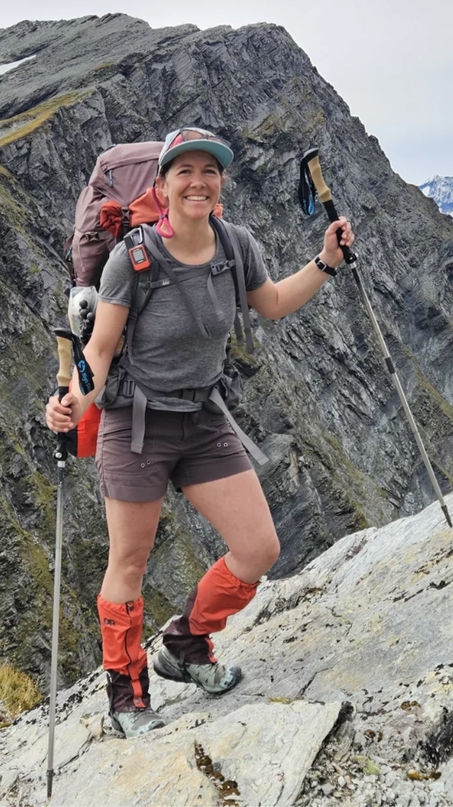
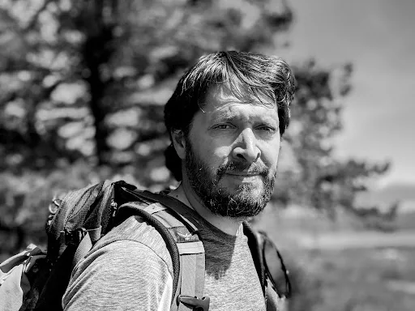




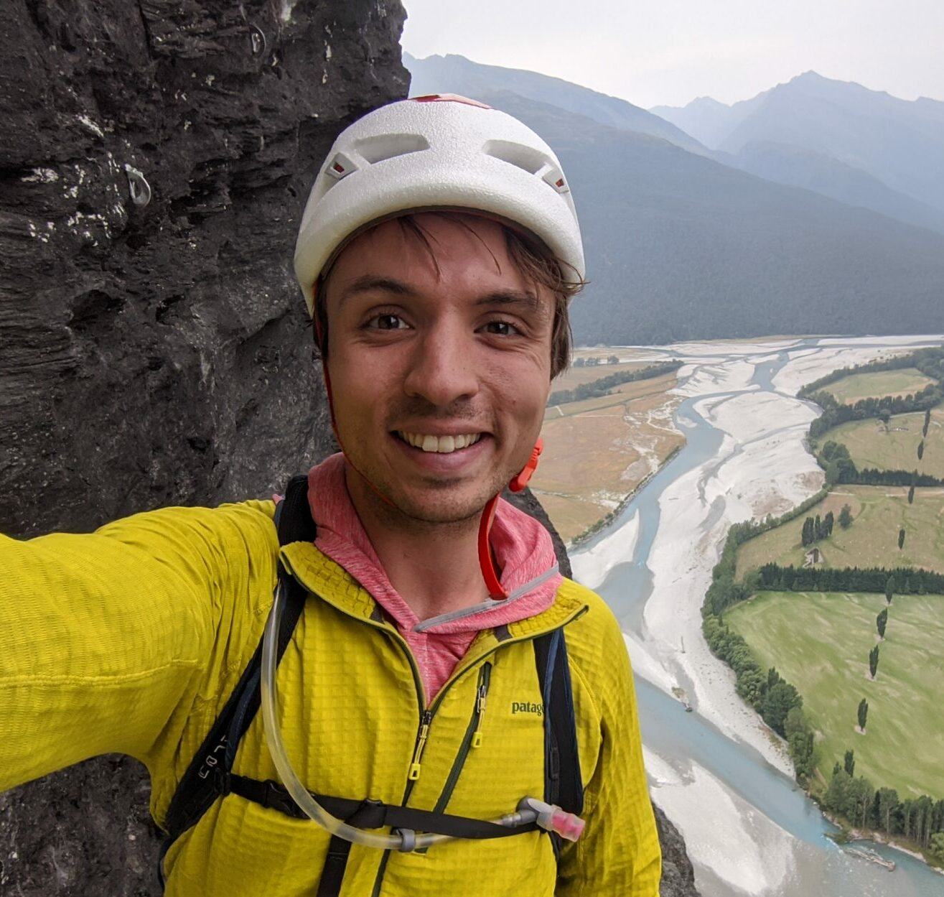
Data Services + Engagement
Chad Trabant
Tammy Bravo
Sarah Wilson
Robert Weekly
Scott Johnson
Alex Hamilton
Sophia Parafina

Slide 3
Workshop Goals
Navigate and work within the GeoLab cloud computing environment
Access and analyze seismic and geodetic data
Use Jupyter Notebooks to explore, process, and analyze data
Understand core cloud concepts and how they apply to your research
Compare local vs. cloud workflows for efficiency and scalability
Identify next steps and resources for after the workshop

Slide 4
Cloud 101 Agenda
Hour 1: Introduction to EarthScope and Cloud Computing
Hour 2: Hands-on with GeoLab: Working with Notebooks, Python, and Obspy
Hour 3: How the Cloud Changes Geophysics and Geodesy
Hour 4: Wrap-Up, Discussion, Survey, and Hands-On Exploration

Slide 5
Introduction to EarthScope and Cloud Computing

Slide 6
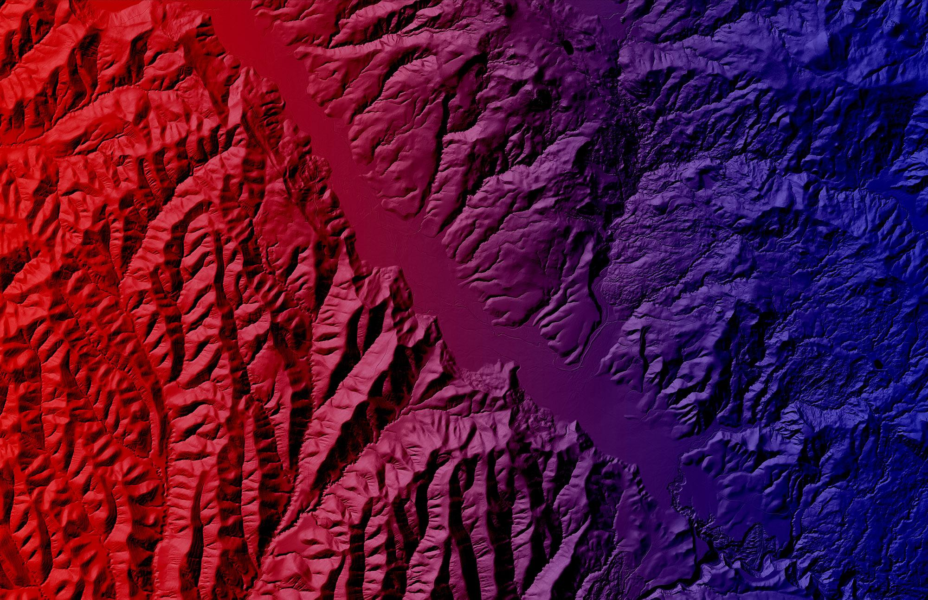
What We Do
We give scientists the tools to examine the Earth with extreme precision to better understand natural hazards and our changing planet.

Slide 7
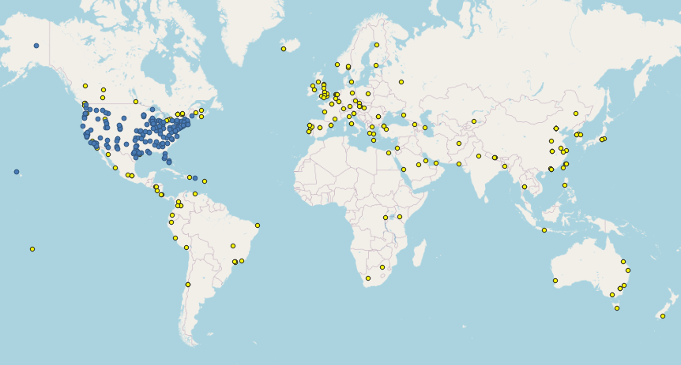
About EarthScope
EarthScope is a global community of scientists, scholars, and educators of 400 voting and associate members
voting members
associate members
Notes:
EarthScope collects geophysical data and applies analytical techniques to gain a deeper understanding of Earth's processes and structure, particularly through the use of its multi-disciplinary observatories and advanced instrumentation. We help scientists develop a comprehensive, time-dependent picture of the earth, addressing key questions in Earth sciences beyond what any single discipline can achieve.
1. Utilizing Geophysical Instrumentation:
EarthScope utilizes and provides a wide variety of geophysical instruments, including seismometers, gravity meters, magnetometers, and GPS systems, to collect data from its observatories. The data is used to study a range of Earth processes, including plate tectonics, earthquakes, mantle dynamics, and the distribution of fluids in the subsurface.
2. Data Analysis and Modeling:
Scientists use geophysical techniques, such as seismic tomography, geodetic analysis, and magnetic data inversion, to analyze the collected data.
They also use advanced geophysical models to simulate and interpret the data, providing insights into the structure and dynamics of the Earth.
3. Addressing Key Questions in Earth Sciences:
EarthScope aims to address fundamental questions about the Earth's interior, surface processes, and the forces that shape our planet.
This includes understanding how geological processes have influenced the landscape of North America and how the Earth's internal structure influences its surface behavior.
4. Educational Outreach:
EarthScope provides educational resources to equip students with the skills and knowledge to use geophysical data for real-world applications. The curriculum addresses issues such as natural hazards, environmental management, and urban planning.

Slide 8
About EarthScope
Maintain and Design Advanced Geophysical Instrumentation
Spans frequency spectrum
Extreme environments, long periods of time
Enable Transformative Data Analysis and Modeling
Adopt standards for data archival, discovery, distribution
Support multidisciplinary research and analysis
Modeling, simulation, machine learning
Investigate Processes and Hazards That Shape the Planet
Inner core to outer atmosphere
Build infrastructure for hazard monitoring
Educational Outreach and Workforce Development
Equip students to engage real-world career opportunities.
Environmental management, urban planning, emergency management, surveying, etc.

Slide 9
Geodesy & Seismology Support
 | Geodetic | Seismologic
Data Archival | GNSS (RINEX), SAR, borehole strainmeters | Short-period and broadband timeseries (miniSEED), associated metadata
Operational Network(s) | Network of the Americas (NOTA) | Global Seismograph Network (GSN), Polar network
Portable Instrumentation Services | GNSS, terrestrial laser scanning, UAV mapping | Seismometers, GPR, magnetotelluric

Slide 10
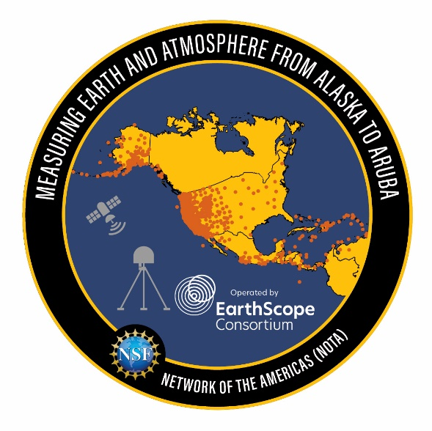
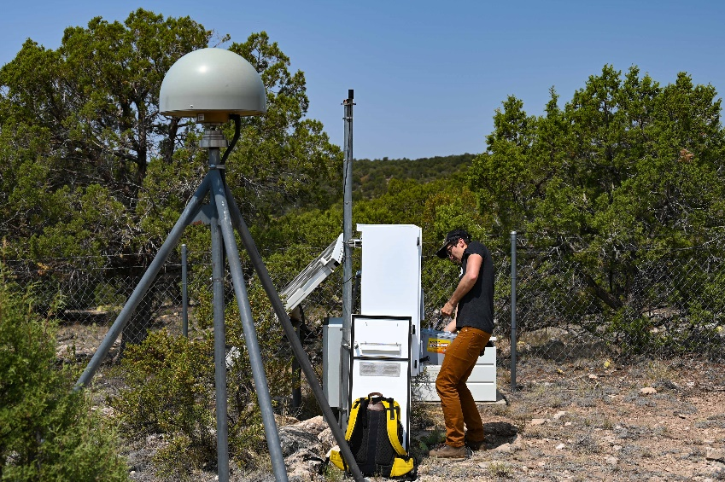
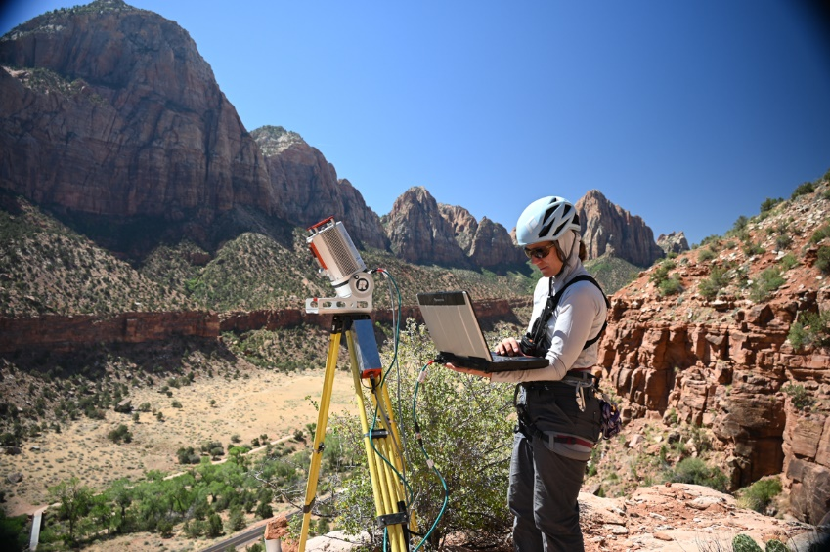
Geodesy support
Data archiving: GNSS, SAR,borehole strain/etc.
Network of the Americas operation (GNSS and borehole)
NASA Global GNSS Network support
Portable instrumentation services: GNSS, terrestrial laser scanning, UAV structure from motion
Notes:
1. Geodetic Data Archiving
EarthScope places a strong emphasis on the archiving and management of geodetic data to ensure that researchers have access to high-quality, standardized datasets. Key aspects of EarthScope's geodetic data archiving efforts include:
UNAVCO Data Archive: EarthScope collaborates with UNAVCO, a non-profit university-governed consortium, to archive and distribute geodetic data. UNAVCO's data archive serves as a central repository for geodetic data collected by EarthScope's Plate Boundary Observatory (PBO) and other global GNSS networks.
Data Standardization: EarthScope ensures that geodetic data is standardized and well-documented, making it easier for researchers to integrate and analyze data from different sources.
Data Accessibility: The EarthScope Data Portal provides researchers with easy access to archived geodetic data. This portal integrates data from various EarthScope components, enabling scientists to perform comprehensive analyses and draw meaningful conclusions.
Long-Term Preservation: EarthScope is committed to the long-term preservation of geodetic data, ensuring that valuable datasets are available for future research and educational purposes.
2. Network of the Americas (NOTA) GNSS and Borehole
EarthScope contributes to the Network of the Americas (NOTA), a comprehensive GNSS network operated by UNAVCO. NOTA plays a crucial role in monitoring the Earth's surface deformation and advancing our understanding of tectonic processes. Key features of NOTA include:
High-Precision GNSS Stations: NOTA employs high-precision GNSS stations to measure the subtle movements of the Earth's crust with millimeter-level accuracy. These stations provide continuous data on surface deformation, enabling researchers to study tectonic plate motions, fault dynamics, and volcanic activity.
Borehole Instrumentation: NOTA includes borehole instruments, such as strainmeters and tiltmeters, which are deployed to measure small-scale deformations and tilts in the Earth's surface. These instruments provide valuable data on the mechanics of fault zones and the behavior of volcanoes.
Comprehensive Coverage: With over 1,100 GNSS stations distributed across North and South America, NOTA provides comprehensive coverage of surface deformation in diverse regions. This coverage is essential for studying the dynamics of plate boundaries, intraplate deformation, and other geodynamic phenomena.
Real-Time Data: NOTA transmits geodetic data in real-time, allowing for rapid analysis and response to significant geological events. This real-time capability is essential for monitoring and assessing geodetic hazards.
3. NASA Global GNSS Network (GGN) Support
EarthScope collaborates with NASA to support the Global GNSS Network (GGN), a worldwide network of high-precision GNSS stations. The GGN plays a crucial role in monitoring global surface deformation and advancing our understanding of geodynamic processes. Key aspects of EarthScope's support for the GGN include:
High-Precision Instrumentation: The GGN employs state-of-the-art GNSS receivers and antennas to capture high-resolution geodetic data from around the world.
Global Coverage: With over 400 GNSS stations distributed across the globe, the GGN provides comprehensive coverage of surface deformation in diverse regions. This coverage is essential for studying global tectonic processes, sea level changes, and other geodynamic phenomena.
Data Integration: EarthScope facilitates the integration of GGN data with other geodetic datasets, enabling researchers to perform comprehensive analyses and draw meaningful conclusions.
Collaborative Research: The GGN facilitates collaborative research by providing a shared infrastructure for geodesists worldwide. This collaboration enhances our understanding of global geodynamic processes and improves our ability to predict and mitigate the impacts of geological hazards.
4. Portable Instrumentation Services
EarthScope offers portable instrumentation services through EPIC. These services provide researchers with flexible and customizable geodetic instrumentation for targeted studies. Key aspects of EarthScope's portable instrumentation services include:
Customizable GNSS Networks: EPIC allows researchers to deploy customizable GNSS networks tailored to specific research questions. This flexibility enables targeted studies of particular regions or events.
Portable Instrument Pool: EPIC maintains a pool of portable geodetic instruments, including high-precision GNSS receivers, strainmeters, tiltmeters, and data loggers. These instruments can be deployed in various configurations to meet the needs of specific research projects.
Field Support: EarthScope provides field support for the deployment and maintenance of portable geodetic instruments. This support includes logistical planning, technical assistance, and data management services.
Educational Opportunities: The portable instrumentation services also support educational initiatives, providing students and early-career researchers with hands-on experience in geodetic data collection and analysis.

Slide 11
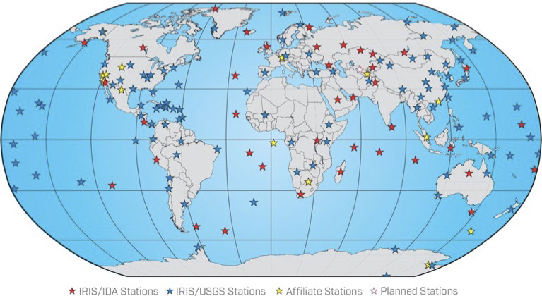
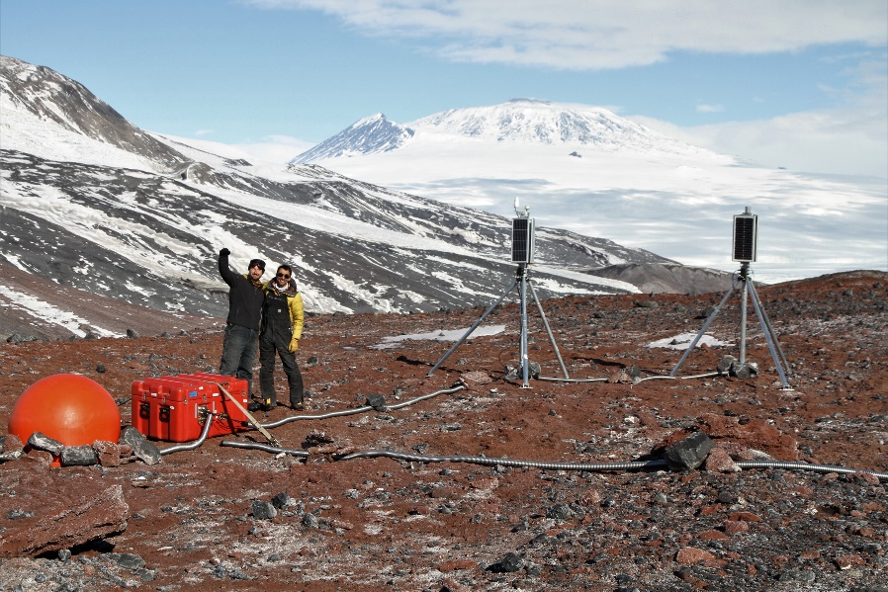
Seismology support
Data archiving: raw seismic and derived products
Global Seismographic Network operation (with USGS)
Portable instrumentation services: seismometers, active-source support, magnetotelluric, ground penetrating radar
Notes:
1. Seismic Data Archiving
EarthScope places a strong emphasis on the archiving and management of seismic data to ensure that researchers have access to high-quality, standardized datasets. Key aspects of EarthScope's data archiving efforts include:
IRIS Data Management Center (DMC): EarthScope collaborates with the Incorporated Research Institutions for Seismology (IRIS) to archive and distribute seismic data. The IRIS DMC serves as a central repository for seismic data collected by EarthScope's USArray and other global seismic networks.
Data Standardization: EarthScope ensures that seismic data is standardized and well-documented, making it easier for researchers to integrate and analyze data from different sources.
Data Accessibility: The EarthScope Data Portal provides researchers with easy access to archived seismic data. This portal integrates data from various EarthScope components, enabling scientists to perform comprehensive analyses and draw meaningful conclusions.
Long-Term Preservation: EarthScope is committed to the long-term preservation of seismic data, ensuring that valuable datasets are available for future research and educational purposes.
2. Global Seismic Network (GSN)
EarthScope contributes to the Global Seismographic Network (GSN), a worldwide network of high-quality seismic stations operated by IRIS and the U.S. Geological Survey (USGS). The GSN plays a crucial role in monitoring global seismic activity and advancing our understanding of the Earth's interior. Key features of the GSN include:
High-Quality Instrumentation: The GSN employs state-of-the-art seismometers and data acquisition systems to capture high-resolution seismic data from around the world.
Global Coverage: With over 150 stations distributed across the globe, the GSN provides comprehensive coverage of seismic activity, enabling researchers to study earthquakes, volcanic activity, and other geological events in diverse regions.
Real-Time Data: The GSN transmits seismic data in real-time, allowing for rapid analysis and response to significant seismic events. This real-time capability is essential for monitoring and assessing seismic hazards.
Collaborative Research: The GSN facilitates collaborative research by providing a shared infrastructure for seismologists worldwide. This collaboration enhances our understanding of global seismic processes and improves our ability to predict and mitigate the impacts of earthquakes.
3. Portable Instrumentation Services
EarthScope offers portable instrumentation services through EPIC (EarthScope Primary Instrument Center). These services provide researchers with flexible and customizable seismic instrumentation for targeted studies. Key aspects of EarthScope's portable instrumentation services include:
Flexible Array: The Flexible Array component of USArray allows researchers to deploy customizable seismic networks tailored to specific research questions. This flexibility enables targeted studies of particular regions or events.
EPIC Instrument Pool: EPIC maintains a pool of portable seismic instruments, including broadband and short-period seismometers, geophones, and data loggers. These instruments can be deployed in various configurations to meet the needs of specific research projects.
Field Support: EarthScope provides field support for the deployment and maintenance of portable seismic instruments. This support includes logistical planning, technical assistance, and data management services.
Educational Opportunities: The portable instrumentation services also support educational initiatives, providing students and early-career researchers with hands-on experience in seismic data collection and analysis.

Slide 12
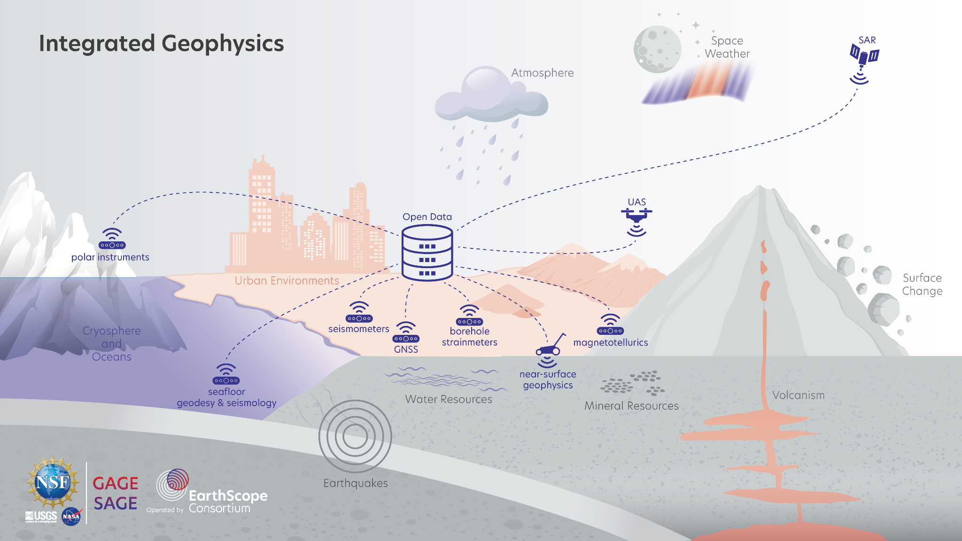
Notes:
Earthscope provides instruments, designed to withstand the extreme conditions globally, including the Arctic and Antarctic Seismometers are deployed to record seismic and by analyzing the seismic waves generated by earthquakes and other geological events, researchers can infer the structure and composition of the Earth's crust and mantle. This information is vital for understanding the tectonic processes that shape these areas and their impact on the Earth’s surface.
Geodesy measures the Earth's geometric shape, orientation in space, and gravitational field. Global Navigation Satellite Systems (GNSS). It is used to monitor the movement and deformation of the Earth's surface. By tracking the subtle changes in the Earth's crust, scientists can gain insights the response of regions to climate and potential impacts such landslides and other hazards.
Magnetotellurics measures the Earth's electrical and magnetic fields to image the subsurface structure.They map the electrical conductivity of the Earth's crust and mantle, providing information about the distribution of fluids and the composition of subsurface rocks.
Synthetic Aperture Radar (SAR) uses radar signals to map the surface of the Earth with high resolution. By analyzing the radar images, scientists can detect changes in the Earth’s surface providing information about the health and stability of environments.
Unmanned Aerial Systems (UAS), or drones, are equipped with various sensors, such as cameras, LiDAR, and hyperspectral imagers, UAS can capture detailed data from the air, offering a unique perspective on these regions. Drones are particularly useful for surveying inaccessible areas, such as mountainous regions, and for monitoring rapid changes in the environment.
EarthScope collects, archives, and distributes seismic and geodetic data.

Slide 13
Data

Slide 14
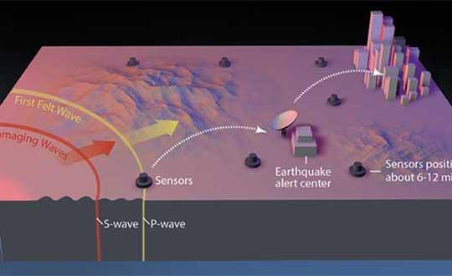
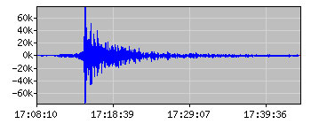
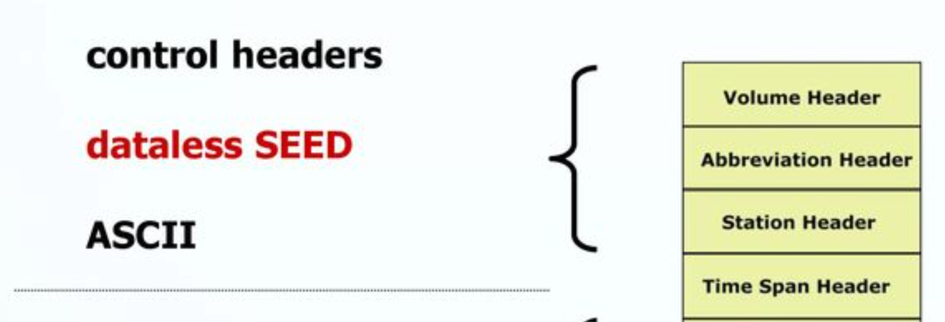
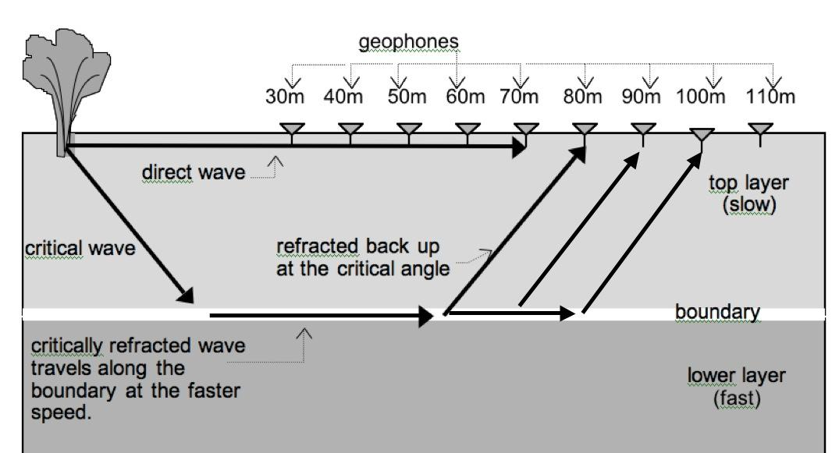
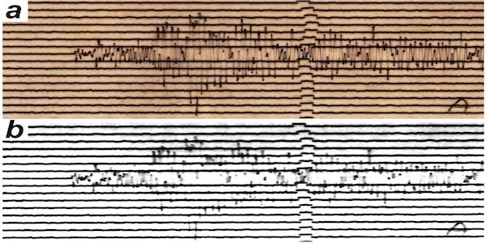
NSF SAGE Data
https://service.iris.edu/
Time Series Data
Metadata
Event Data
Assembled Data
Historical Data
Notes:
Learning Objectives: 2.1, 2.4
1. Time Series Seismic Data
Time series seismic data are continuous recordings of ground motion captured by seismometers. These data are fundamental for studying earthquakes, volcanic activity, and other geological events. The SAGE data archives include:
Raw Waveform Data: High-resolution recordings of seismic waves from EarthScope's USArray and other global seismic networks. These waveforms provide detailed information about the amplitude, frequency, and phase of seismic signals.
Processed Waveform Data: Time series data that have been processed to remove noise, correct for instrument response, and enhance the signal quality. These processed waveforms are essential for detailed analyses of seismic events.
2. Metadata
Metadata provides essential contextual information about the seismic data, ensuring that researchers can accurately interpret and analyze the datasets. The SAGE data archives include:
Station Information: Details about the location, instrumentation, and operational status of seismic stations. This information is crucial for understanding the spatial distribution and capabilities of the seismic network.
Data Quality: Metadata on the quality and reliability of the seismic data, including information about data gaps, noise levels, and instrument calibration.
Event Information: Metadata related to specific seismic events, such as earthquakes and volcanic eruptions, including the event's location, magnitude, and timing.
3. Event Data
Event data are specific datasets related to significant seismic events, such as earthquakes and volcanic eruptions. The SAGE data archives include:
Earthquake Catalogs: Comprehensive lists of earthquakes, including their location, magnitude, depth, and timing. These catalogs are essential for studying the distribution and characteristics of seismic activity.
Source Parameters: Detailed information about the source mechanisms of earthquakes, including focal mechanisms, moment tensors, and stress drop estimates. These parameters help researchers understand the physics of earthquake rupture.
Aftershock Sequences: Data on the aftershocks that follow major earthquakes, providing insights into the stress redistribution and fault healing processes.
4. Historical Data
Historical data are archived datasets that span decades, providing a long-term perspective on seismic activity and Earth processes. The SAGE data archives include:
Legacy Seismic Data: Seismic recordings from historical seismic networks and instruments, some dating back to the early 20th century. These data are valuable for studying long-term trends in seismic activity and tectonic processes.
Historical Event Catalogs: Comprehensive lists of historical earthquakes and other seismic events, providing a long-term record of seismic activity.
Archived Waveforms: Historical time series data that have been digitized and archived for modern analysis. These waveforms provide insights into past seismic events and the evolution of seismic instrumentation.
5. Assembled Data
Assembled data are datasets that have been compiled and processed to address specific research questions or to provide integrated views of seismic activity. The SAGE data archives include:
Tomographic Models: Three-dimensional models of the Earth's interior, constructed from seismic wave travel times and amplitudes. These models provide insights into the structure and composition of the Earth's crust and mantle.
Velocity Models: Models of seismic wave velocities in the Earth's interior, which are essential for understanding the propagation of seismic waves and the properties of the Earth's materials.
Integrated Datasets: Compiled datasets that combine seismic data with other geophysical and geodetic data, such as GPS measurements and gravity anomalies. These integrated datasets provide a holistic view of Earth processes.

Slide 15
Current SAGE Data Access
Web services: https://service.iris.edu/
Download tools: https://ds.iris.edu/ds/nodes/dmc/software/meta/categories/data-access/
Preferred method for data access:
Python packages:
obspy
pyrocko
Notes:
Learning Objectives: 2.1, 2.4

Slide 16
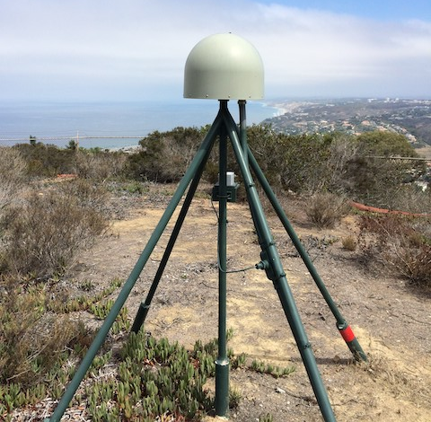
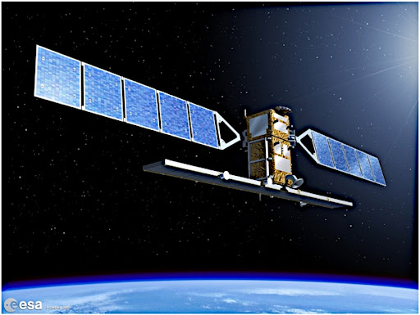
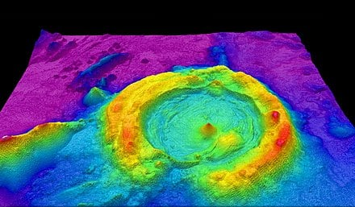
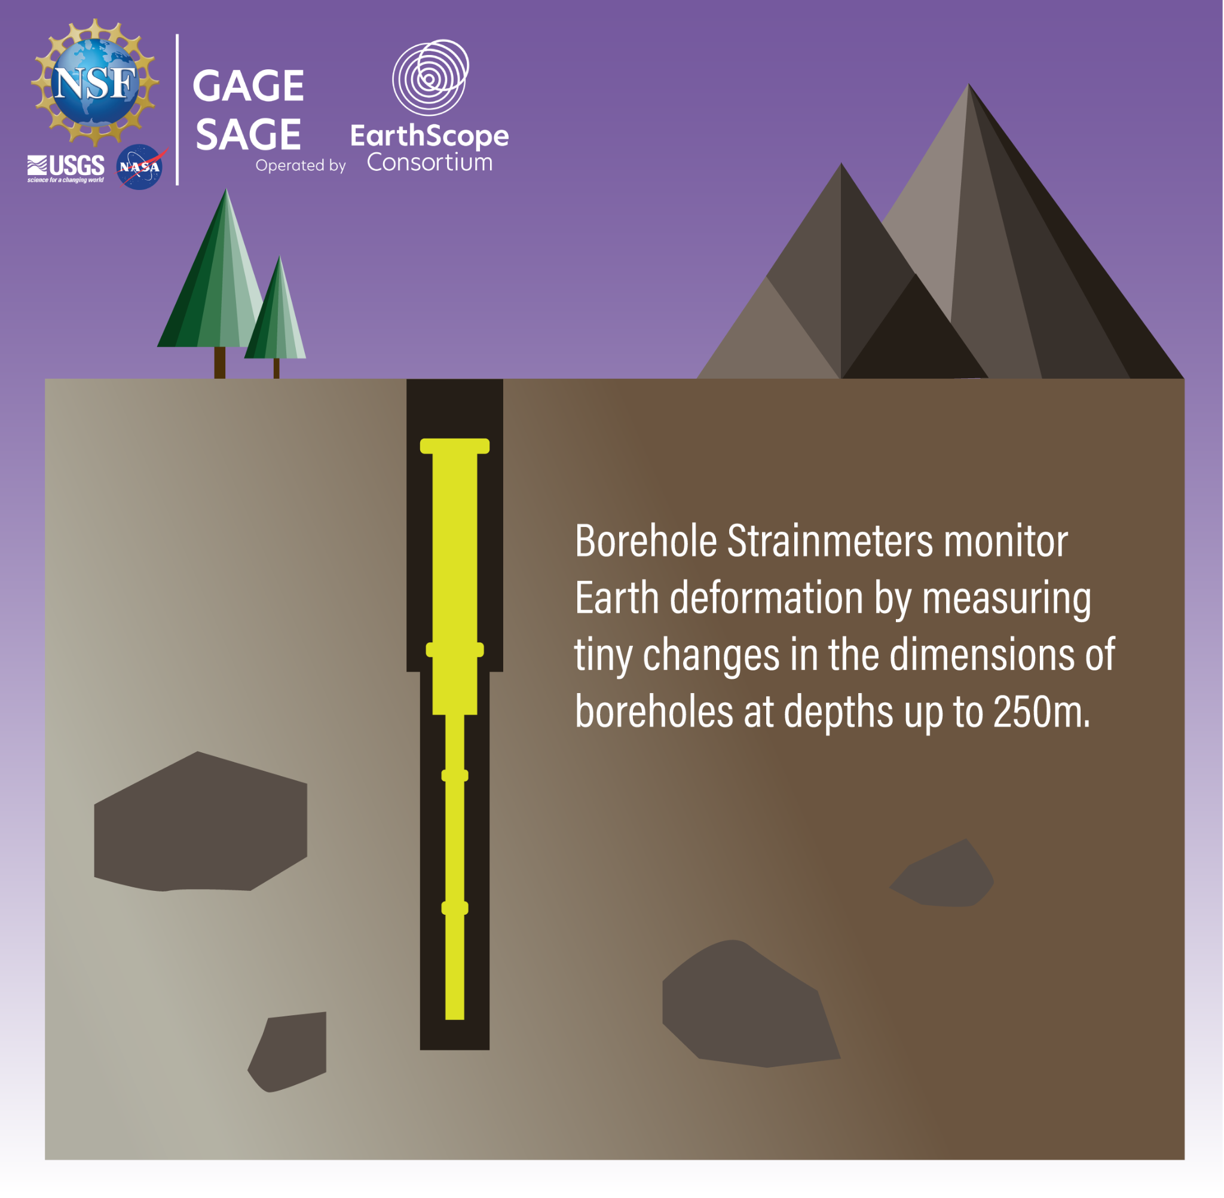
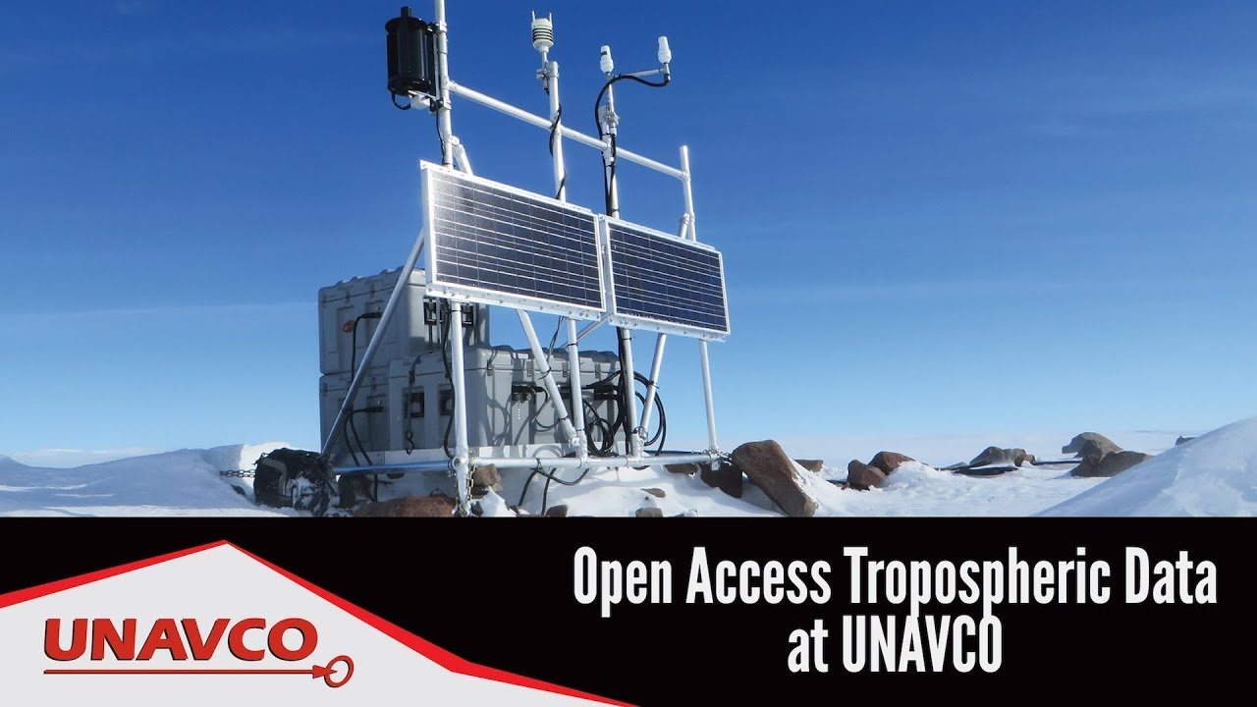
NSF GAGE Data
LIDAR/SfM
Synthetic Aperture Radar (SAR)
GPS/GNSS Data
Tropospheric Data
Strain & Seismic Data
Notes:
Learning Objectives: 2.1, 2.4
1. GNSS Data
Global Navigation Satellite System (GNSS) data are crucial for monitoring the Earth's surface deformation with high precision. EarthScope's GAGE facilities provide access to comprehensive GNSS datasets, which include:
High-Precision Coordinates: Continuous measurements of the Earth's surface positions with millimeter-level accuracy.
Time Series Data: Long-term records of surface displacements, which are essential for studying tectonic plate motions, fault dynamics, and volcanic activity.
Metadata: Detailed information about GNSS stations, including location, instrumentation, and data quality.
2. Synthetic Aperture Radar (SAR) Data
SAR data provide high-resolution images of the Earth's surface, enabling the detection of subtle changes in topography and surface deformation. EarthScope's GAGE facilities offer access to SAR datasets, which include:
Interferometric SAR (InSAR): Data that allow for the measurement of surface deformation by comparing phase differences between SAR images taken at different times.
Topographic Maps: High-resolution maps of the Earth's surface, which are useful for studying landforms, glaciers, and other geological features.
Change Detection: Time series of SAR images that can be used to monitor changes in the Earth's surface, such as landslides, subsidence, and glacial retreat.
3. LiDAR Data
Light Detection and Ranging (LiDAR) data provide detailed three-dimensional maps of the Earth's surface. EarthScope's GAGE facilities offer access to LiDAR datasets, which include:
High-Resolution Topography: Detailed elevation models of the Earth's surface, which are essential for studying landforms, vegetation, and infrastructure.
Point Clouds: Raw LiDAR data that can be processed to generate digital elevation models (DEMs) and other topographic products.
Vegetation Analysis: Data that can be used to study the structure and health of vegetation, including forests and agricultural crops.
4. Atmospheric Data
Atmospheric data are essential for understanding the interactions between the Earth's surface and the atmosphere. EarthScope's GAGE facilities provide access to atmospheric datasets, which include:
Meteorological Observations: Data on temperature, pressure, humidity, and wind speed, which are crucial for studying weather patterns and climate change.
Atmospheric Profiles: Vertical profiles of atmospheric parameters, such as temperature, humidity, and wind speed, which are essential for understanding atmospheric dynamics.
Precipitation Data: Records of rainfall, snowfall, and other precipitation events, which are important for studying hydrological processes and water resources.
5. Strain and Seismic Borehole Data
Strain and seismic borehole data provide insights into the deformation and seismic activity of the Earth's crust. EarthScope's GAGE facilities offer access to these datasets, which include:
Strainmeter Data: Continuous measurements of the Earth's surface strain, which are essential for studying fault dynamics, volcanic activity, and other geological processes.
Borehole Seismic Data: High-resolution seismic data collected from boreholes, which provide detailed information about the structure and properties of the Earth's crust.
Tiltmeter Data: Measurements of the Earth's surface tilt, which are useful for studying volcanic inflation, landslides, and other surface deformation processes.

Slide 17
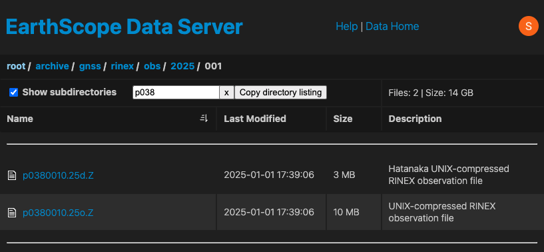
Current GAGE Data Access
File server
https://data.earthscope.org/
Notes:
Learning Objectives: 2.1, 2.4

Slide 18
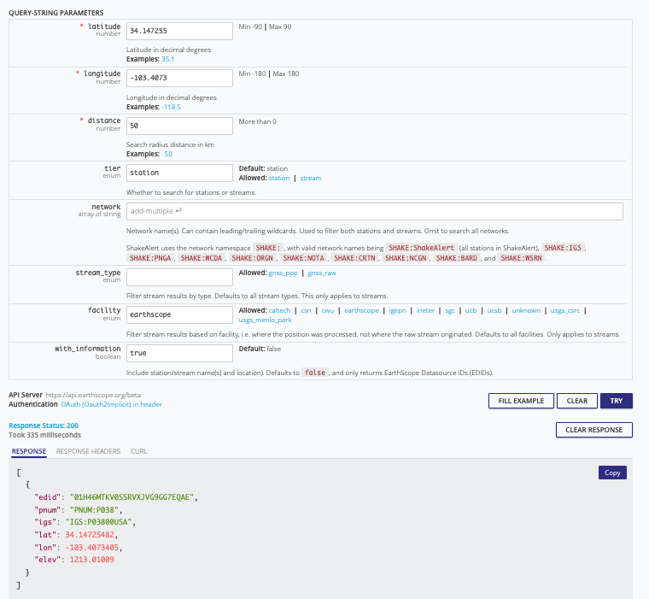
Current GAGE Data Access
https://api.earthscope.org/
Requires authentication with EarthScope CLI
Notes:
Learning Objectives: 2.1, 2.4
EarthScope provides a web page to assist in finding and downloading data.

Slide 19
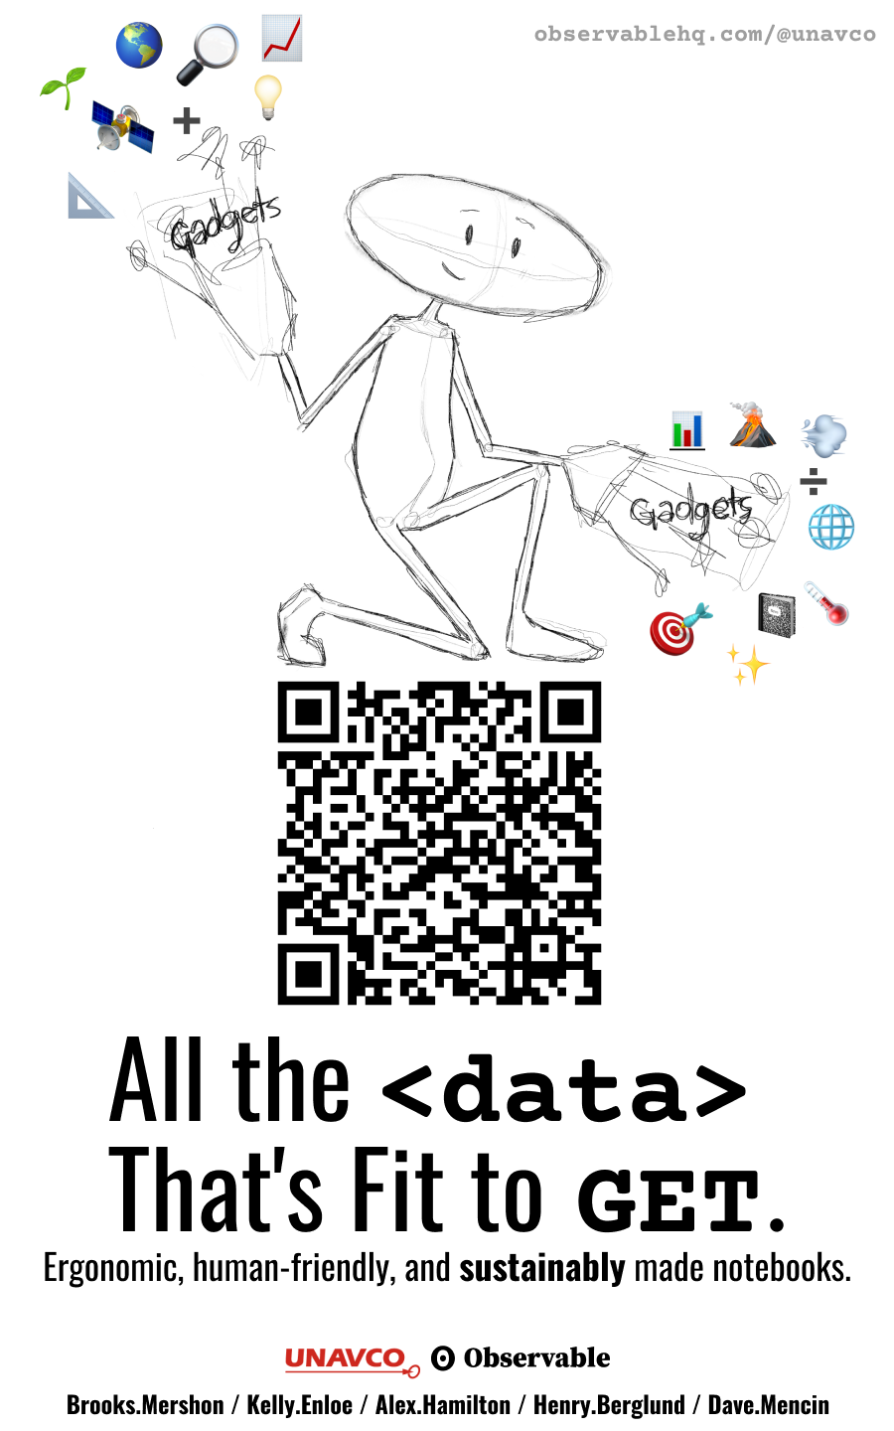
Observable Notebooks
(@earthscope)
Use open-source notebooks for data access, analysis, visualization:
Create RINEX data requests
Geoid Height Calculator
Earth Model Collaboration (EMC) contribution and visualization
GMV and other SPUD products
https://observablehq.com/@earthscope

Slide 20
On-Ramp to the Cloud

Slide 21
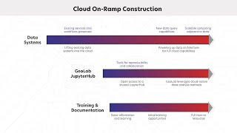
On-Ramp
Notes:
Learning objective: 19 -22

Slide 22
Analysis Ready Data for Geophysics
Analysis-Ready, Cloud-Optimized (ARCO) principles guide moving data to the cloud.
ARCO data reduces downloading and preparation of large datasets for analysis.
Notes:
Lift & Shift
→ designed to not disrupt existing processes and

Slide 23
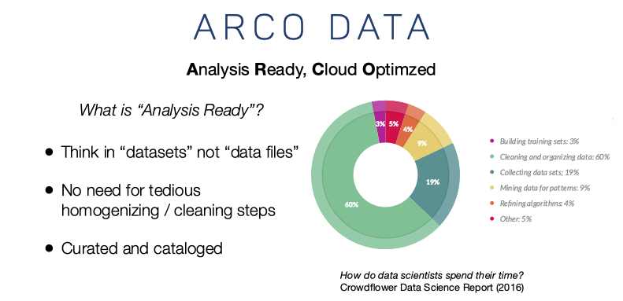
ARCO Advantages
credit: R. Abernathy/ Pangeo Project
https://speakerdeck.com/rabernat/beyond-fair-what-data-infrastructure-does-open-science-need?slide=33
Notes:
1. Reduced Preprocessing Time
Minimal Data Cleaning: ARD is preprocessed to remove noise, correct for instrument response, and standardize formats, reducing the time researchers spend on data cleaning and preparation.
Consistent Quality: ARD undergoes rigorous quality control measures, ensuring that the data is reliable and consistent across different datasets.
2. Enhanced Data Accessibility
Standardized Formats: ARD is provided in standardized formats, making it easier for researchers to integrate and analyze data from different sources.
Metadata Inclusion: Comprehensive metadata is included with ARD, providing detailed information about the data's origin, processing methods, and quality, which is essential for accurate interpretation.
3. Improved Data Integration
Interoperability: ARD is designed to be interoperable with various analysis tools and software, facilitating seamless integration with other datasets and analytical workflows.
Multi-Disciplinary Use: ARD supports multi-disciplinary research by providing data that can be easily combined with other types of geophysical, geodetic, and environmental data.
4. Increased Research Efficiency
Rapid Analysis: With ARD, researchers can quickly move from data acquisition to analysis, accelerating the research process and enabling more timely scientific discoveries.
Focus on Science: By reducing the time spent on data preprocessing, researchers can focus more on scientific analysis and interpretation, leading to more productive research outcomes.
5. Enhanced Data Reproducibility
Transparent Processing: ARD includes detailed documentation of the preprocessing steps, ensuring that the data can be reproduced and validated by other researchers.
Consistent Results: The use of standardized preprocessing methods ensures that results are consistent and comparable across different studies.
6. Support for Advanced Analytical Techniques
Machine Learning and AI: ARD is well-suited for advanced analytical techniques, such as machine learning and artificial intelligence, which require high-quality, standardized input data.
Big Data Analytics: ARD facilitates big data analytics by providing large, well-organized datasets that can be efficiently processed and analyzed.
7. Improved Data Sharing and Collaboration
Open Access: ARD is often made available through open-access platforms, promoting data sharing and collaboration among researchers.
Community Standards: ARD adheres to community standards and best practices, ensuring that the data is widely accepted and used by the scientific community.
8. Enhanced Data Visualization
Visualization Tools: ARD is compatible with various visualization tools, enabling researchers to create high-quality visualizations and better communicate their findings.
Interactive Exploration: ARD supports interactive data exploration, allowing researchers to dynamically explore and analyze the data.

Slide 24
Hands-on with Jupyter, GeoLab, and Git

Slide 25
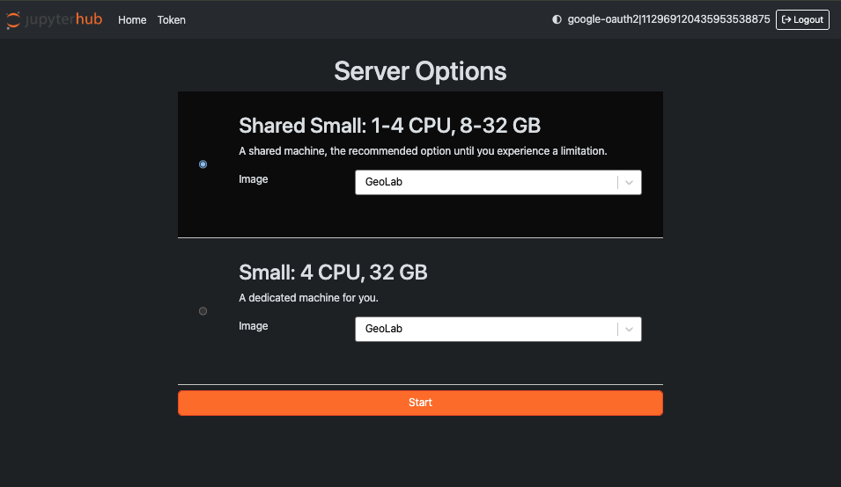
GeoLab
https://www.earthscope.org/data/geolab/

Slide 26
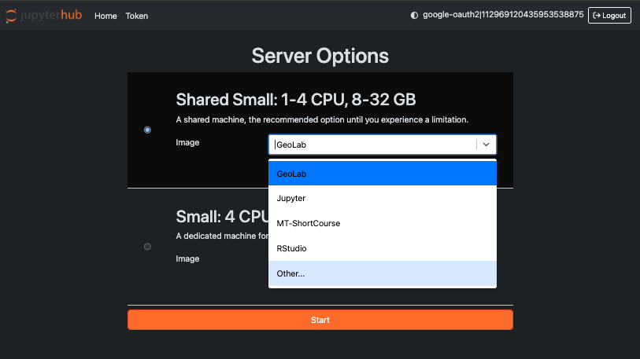
GeoLab: Server Options

Slide 27
JupyterHub and GeoLab
JupyterHub offers compute environments hosted on shared infrastructure
GeoLab is a cloud computing platform for the geophysical community, built in collaboration with 2i2c.
Adjacent to EarthScope-operated data archives
GeoLab offers two instance sizes:
Small Shared: 1-4 CPU, 8-32 GB
Small Dedicated: 4 CPU, 32 GB
Notes:
JupyterHub
Multi-User Support:
Enables multiple users to access their own Jupyter notebooks simultaneously.
Each user has a personalized workspace, ensuring data privacy and customization.
Scalability:
Can be deployed on cloud platforms or local servers, scaling to accommodate hundreds or thousands of users.
Supports integration with Kubernetes for dynamic resource allocation.
Customizable Environments:
Users can configure their computing environments with different kernels (e.g., Python, R, Julia) and software libraries.
Supports Docker and Conda environments for reproducible research.
Collaboration and Sharing:
Facilitates real-time collaboration through shared notebooks and interactive coding sessions.
Supports integration with version control systems like Git for collaborative projects.
Authentication and Security:
Integrates with various authentication providers (e.g., OAuth, LDAP, GitHub) to manage user access securely.
Provides role-based access control to manage permissions and resources.
Interactive Computing:
Supports interactive data visualization and analysis with libraries like Matplotlib, Plotly, and Bokeh.
Enables real-time data exploration and machine learning model training.
Educational and Research Applications:
Widely used in academic settings for teaching coding, data science, and computational methods.
Supports reproducible research by allowing users to share notebooks with embedded code, visualizations, and explanations.
Extensibility:
Supports extensions and plugins to enhance functionality, such as JupyterLab extensions for additional features.
Can be integrated with other tools and services, such as databases, APIs, and cloud storage.

Slide 28
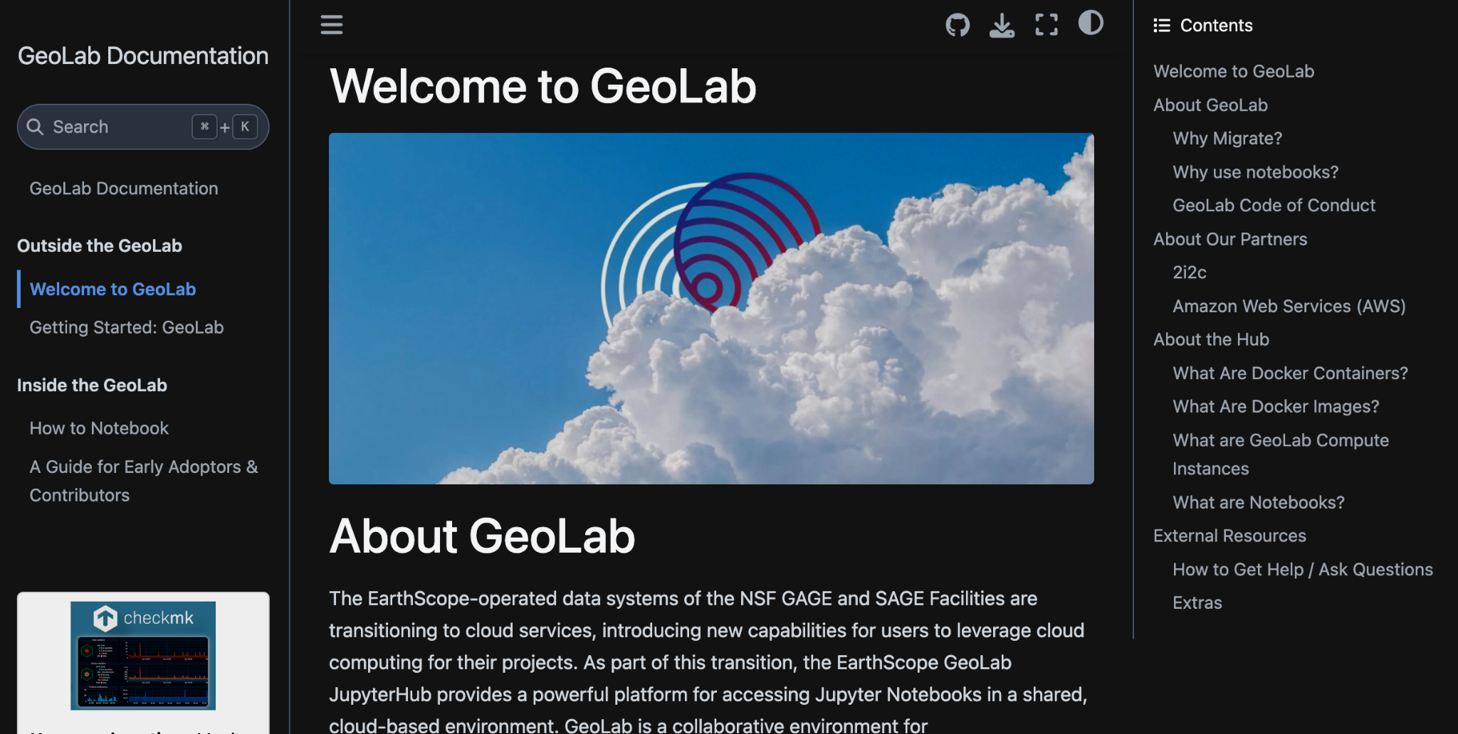
GeoLab: Read the Docs
https://docs.earthscope.org/projects/GeoLab
Notes:
GeoLab documentation is available through Read the Docs

Slide 29
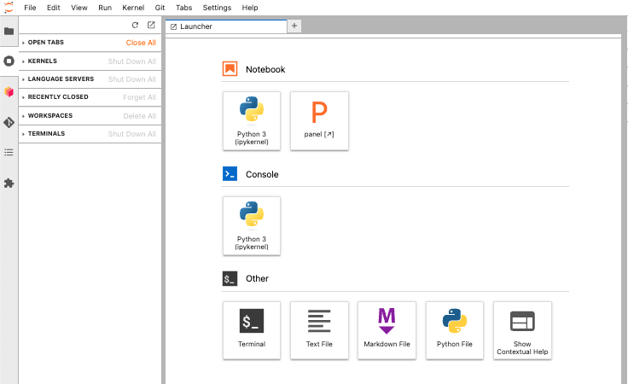
JupyterHub Tour
Notes:
Features:
Launcher Page
Terminal – useful for setting environment variables and secrets
Create text, Markdown, and Python
Console – REPL
Notebook
Dask dashboard
Left Menu:
a file browser
a list of tabs in the main work and of running kernels and terminals,
GPU dashboard
Dask dashboard
Git dashboard
Notebook table of contents
JupyterBook - a wrapper around a collection of tools in the Python ecosystem that make it easier to publish computational documents.
the extension manager.
Shared folder? Make sure people are in the right image, in the right folder
Work with Sara to ensure logistics for image

Slide 30
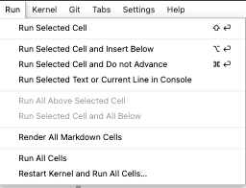
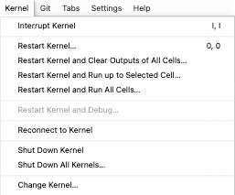
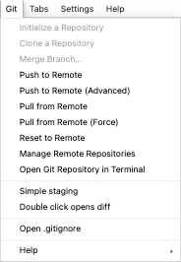

GeoLab Tour
Notes:
File Menu
The File menu in JupyterHub is essential for managing notebooks and files, allowing users to create, open, and organize their work. It provides options to save progress, create checkpoints, and download files for offline access. Additionally, it enables users to close notebooks and halt kernels, freeing up resources when tasks are complete.
Edit Menu
The Edit menu offers tools for modifying and organizing notebook content, including standard editing functions like cut, copy, and paste. Users can delete, split, or merge cells, and reorder them to structure their notebook logically. It also includes a Find and Replace feature for bulk text changes and keyboard shortcuts for enhanced productivity.
View Menu
The View menu customizes the notebook interface, allowing users to toggle the header and toolbar for more screen space or additional tools. It displays extra cell functionalities and toggles line numbers in code cells for easier debugging. Users can also show or hide cell outputs to focus on results or maintain a cleaner view.
Insert Menu
The Insert menu simplifies adding new content to notebooks, enabling users to insert cells above, below, or at the bottom of the notebook. This menu is particularly useful for expanding analysis without disrupting the existing notebook flow. It provides a quick way to add new sections or extend computations.
Cell Menu
The Cell menu is crucial for executing and managing notebook cells, allowing users to run current or all cells to see results. It offers flexibility in presenting content by changing cell types between code, markdown, raw, and heading. Users can also run cells incrementally for testing or debugging and clear outputs to manage results display.
Kernel Menu
The Kernel menu manages the computational engine, enabling users to interrupt, restart, or reconnect to kernels for troubleshooting or fresh starts. It allows restarting kernels and running all cells to ensure notebooks execute from scratch. Users can also shut down kernels or change them to switch programming languages or environments.
Widgets Menu
The Widgets menu manages interactive notebook elements, allowing users to save or clear widget states to preserve or reset customizations. It provides a list of all interactive widgets, helping users track and manage dynamic elements. This menu ensures that widget configurations are maintained or reset as needed.
Help Menu
The Help menu is a resource for learning and troubleshooting, offering a user interface tour for new users and access to documentation. It includes a Markdown help reference for text formatting and a list of keyboard shortcuts for productivity. Users can also access information about the JupyterHub version and configuration for context.

Slide 31
Collaboration with Git
Git is a version control system that:
Tracks code changes in files
Tracks who made changes
Enables coding collaboration
Two commonly used git providers
GitHub
GitLab
Notes:
Git is a tool that helps teams track and manage changes to their code, making collaboration smoother and more organized. It allows developers to work on different parts of a project simultaneously without interfering with each other's work. By keeping a complete history of all changes, Git ensures that everyone stays on the same page and can easily revert to previous versions if needed.

Slide 32
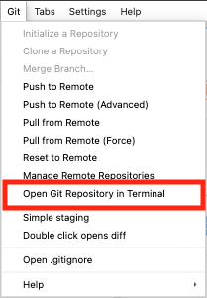
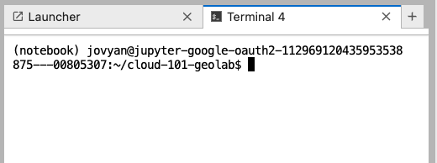
Getting Started with git
Notes:
Open a Terminal
Use the cd command to move to the directory where you want to clone the repository.

Slide 33
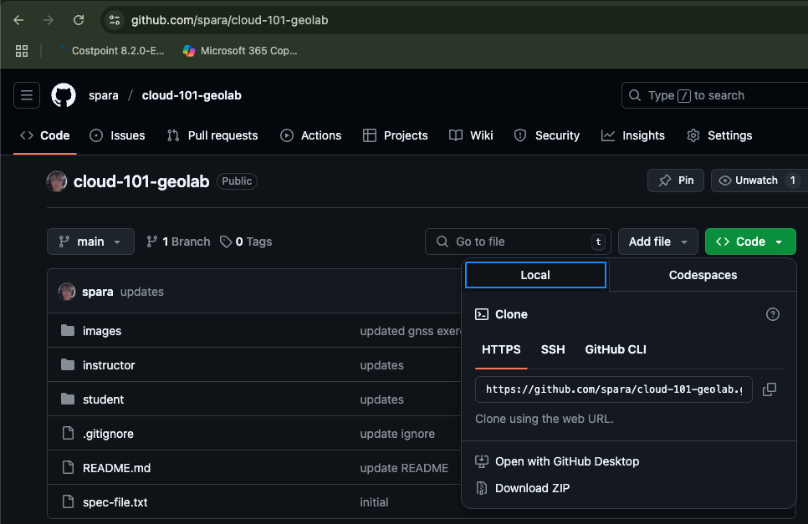
Clone repository
https://github.com/spara/cloud-101-geolab
Notes:
Go to the Git repository you want to clone (e.g., on GitHub, GitLab, or Bitbucket).
Click on the "Code" button and copy the repository URL (HTTPS or SSH).

Slide 34
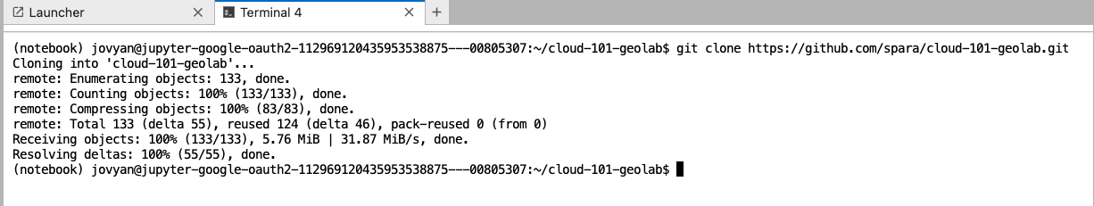
Clone repository
git clone https://github.com/spara/cloud-101-geolab.git
Notes:
Clone the Repository
Use the git clone command followed by the repository URL.
Navigate into the Cloned Repository
Use the cd command to enter the cloned repository directory.
Verify the Cloned Repository
List the files to ensure the repository has been cloned successfully.

Slide 35
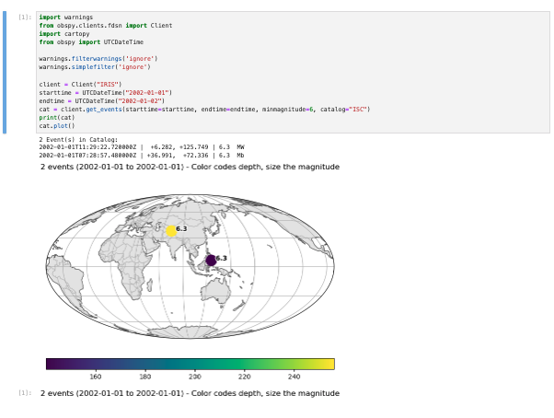
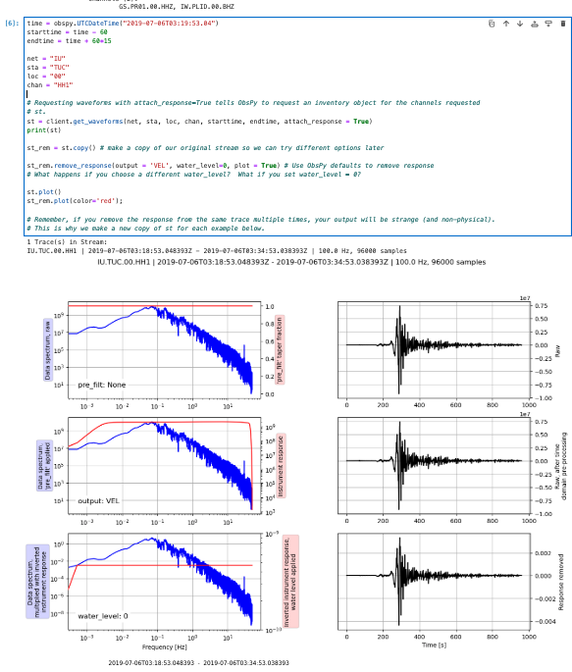
Python and obspy follow along

Slide 36
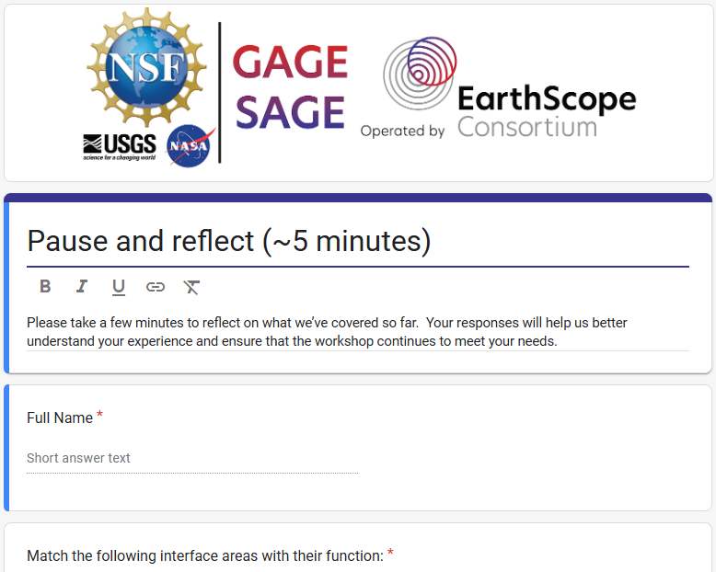
Take 5 minutes to Reflect
Please take 5 minutes to complete the short reflection linked in the online agenda
Your responses will help us understand what’s connecting and what still feels unclear
Please open the link in the agenda under hour 2 to begin
earthscope.org/cloud-101

Slide 37
Adapting Geophysics Workflows for the Cloud

Slide 38
EarthScope API
The beta API is available at api.earthscope.org.
APIs can be leveraged in any environment or language that can perform web queries
Example queries and syntax assist constructing cURL or Wget command line arguments.
For GAGE data, the API (beta) supports querying of instantaneous position data from TileDB arrays.
The API supports radial station search, Network, Station, and Stream lookup tools.

Slide 39
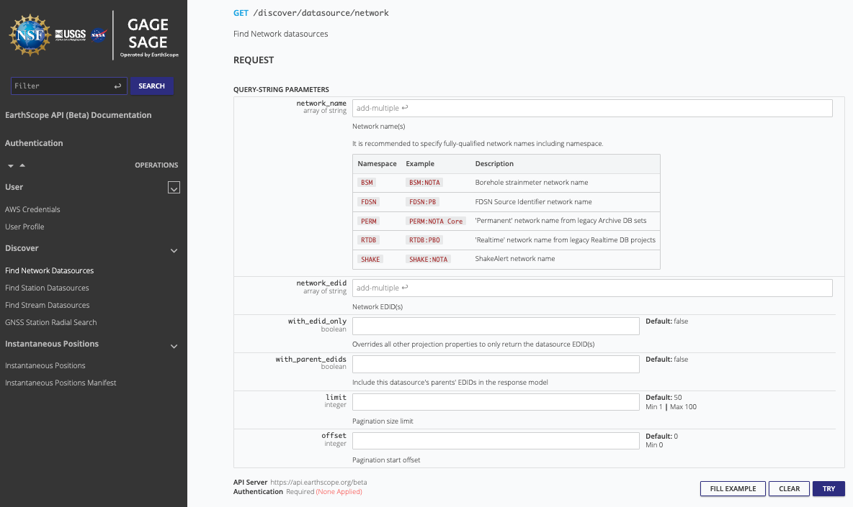
EarthScope API

Slide 40
EarthScope SDK
Software Development Kit (SDK)
Cloud data access and authentication paradigms introduces challenging workflows for researchers.
EarthScope is developing a Python SDK to support identity management, AWS account configurations, and API calls.
Some functionality around authentication is already available; updates are anticipated throughout 2025.

Slide 41
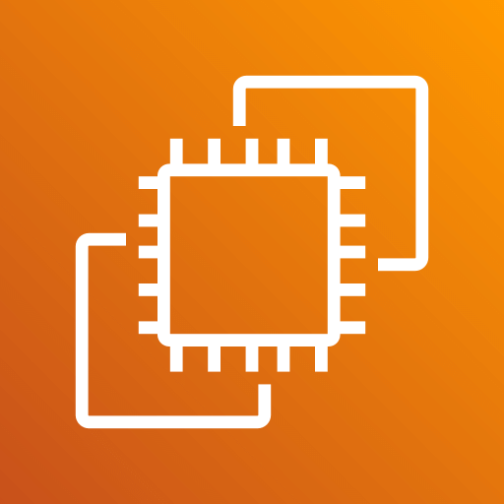


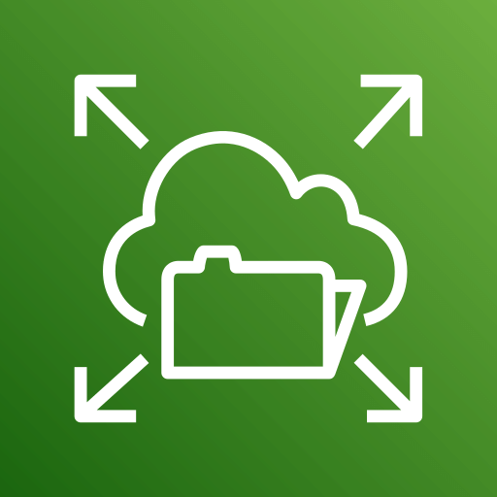
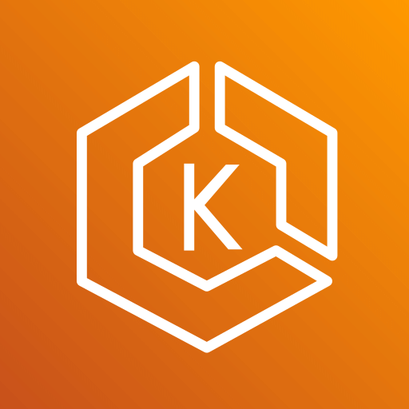
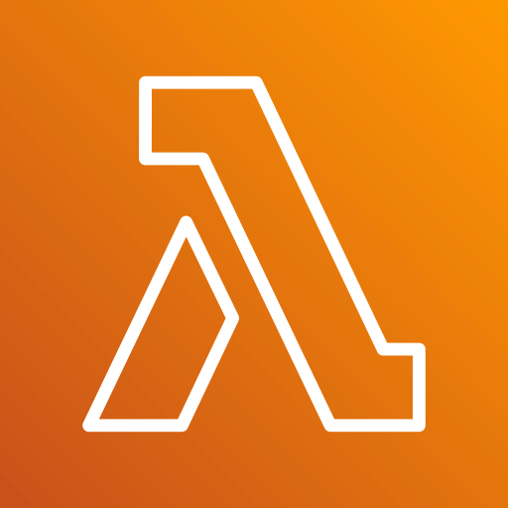

Cloud Computing Concepts:
Basic services
 | Compute |  | Storage
 | virtual machines |  | object storage (S3)
 | containers |  | file storage (EFS read & write)
 | Kubernetes
 | serverless
Notes:
Virtual Machines: Like having multiple computers running on a single physical machine, each with its own operating system.
Containers: Lightweight, portable boxes that hold everything an app needs to run, making it easy to move and deploy.
Serverless: Cloud services that run your code without you having to manage any servers.
Object Storage: A vast, scalable storage system for unstructured data like photos or videos, accessed by unique names.
File Storage: Traditional storage for files and folders, like a shared network drive, organized in a hierarchy.

Slide 42
Compute and Storage
Compute - Virtual Machines running Containers
Containers provide an environment with required software and all their dependencies
Object storage – S3
Used for storing large volumes of data (petabytes) that need to be durable. Consist of data, metadata, and a unique identifier. Objects are not read/write.
File storage - EFS
Hierarchical (folders/directories) and works like desktop computer file systems. Data is directly read/write.
Notes:
have a scratch directory, S3 bucket, have to use aw cli
https://docs.2i2c.org/user/topics/data/filesystem/#the-tmp-directory

Slide 43
GeoLab Packages
conda list
argopy | numpy
arrow | pandas
aws/boto3 | python 3.12
azure | pytorch
cartopy | seaborn
dask | tiledb
matplotlib | xarray
Notes:
You can use either the JupyterLab extensions/pypi manager or use the conda package manager in the terminal

Slide 44
Graphics Processing Unit (GPU)
Graphics Processing Units - contain multiple processors that enable parallel processing, especially floating point calculations
Designed for generating graphics, but useful for machine learning
Python packages that use - typically require the NVIDIA CUDA (Compute Unified Device Architecture) Toolkit
Notes:
- accelerate seismic migration algorithms for faster and more accurate subsurface imaging.
- enable rapid full waveform inversion to build high-resolution velocity models of the Earth.
- speed up the analysis of seismic attributes for enhanced reservoir characterization.
- facilitate faster noise reduction and filtering in large 3D seismic datasets.
- accelerate forward modeling in electromagnetic methods for efficient survey design.
- make 3D electromagnetic inversion practical for subsurface resistivity mapping.
- enable faster potential field calculations for gravity and magnetic data analysis.
- speed up source inversion in gravity and magnetic data to locate subsurface anomalies.
- accelerate geothermal modeling for efficient resource assessment.
- enhance the speed of volcanic process simulations for improved hazard assessment.
- provide the computational power needed for large-scale groundwater modeling.
- significantly accelerate the training and deployment of machine learning models for geophysical applications.
- enable real-time interactive visualization of large 3D geophysical datasets.

Slide 45
GeoLab: Cloud Workflows
Considerations
Resource | Shared | Dedicated
Memory | 8 - 32 GB | 32 GB
Processors | 1 - 4 | 4
Storage | 50 GB | 50 GB
Cost | TBD | TBD
Notes:
1. Compute Resources:
Instance Types: Selecting appropriate virtual machine instances with the right CPU, GPU, and memory configuration is crucial for performance and cost-efficiency. Geophysics processing often demands high-performance computing (HPC) instances with powerful processors and GPUs.
Scalability: Cloud platforms offer the ability to dynamically scale compute resources up or down based on the workload. This is essential for handling the varying computational demands of different processing stages or large datasets.
2. Data Storage:
Storage Capacity: Geophysics datasets, especially seismic data, can be enormous (petabytes). Sufficient and scalable cloud storage solutions are necessary to accommodate these volumes.
Storage Types and Costs: Different cloud storage options (e.g., object storage, block storage, archive storage) have varying performance characteristics and costs. Choosing the right type based on data access frequency and performance needs is important for cost optimization.
Data Ingress and Egress: Transferring large volumes of data into and out of the cloud can incur significant costs and time. Efficient data transfer strategies and understanding the cloud provider's data transfer pricing are crucial.
3. Network Resources:
Bandwidth: High bandwidth is required for efficient data transfer between storage and compute resources, as well as for accessing the cloud environment. Network performance can significantly impact processing times.
Latency: For interactive analysis or real-time processing, low network latency is desirable. The geographical location of the cloud data center relative to the user can affect latency.
4. Software and Licensing:
Cloud-Optimized Software: Some geophysics software may need to be optimized or configured for cloud environments to take full advantage of the available resources.
5. Data Management and Governance:
Data Locality: Depending on regulatory requirements or performance considerations, the geographical location of the data storage might be important.-
Data Security and Compliance: Implementing appropriate security measures and ensuring compliance with relevant regulations are paramount when storing and processing sensitive geophysical data in the cloud.
Don’t keep critical data, reserve right to clear home directories

Slide 46
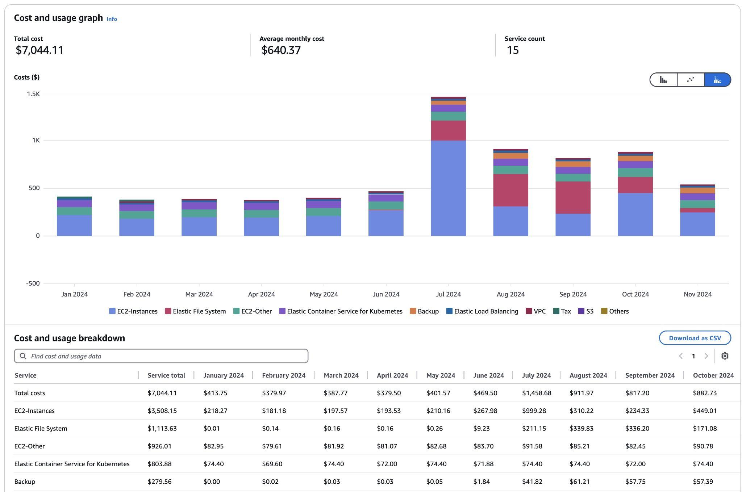
GeoLab: Cost

Slide 47
Directed Acyclic Graphs (DAGs)
A graph where nodes are linked by one-way connections that do not form any cycles.
DAGs illustrate dependencies and causal relationships.
Helpful for visualizing relationships between nodes representing data, tasks or events.
Workflows are DAGs
Notes:
Think of building a house: you can't put on the roof before the walls are up, and the walls can't go up before the foundation is laid. A directed acyclic graph (DAG) for cloud workflows is like the blueprint for your house construction. Each task, like "pour foundation," "frame walls," or "install roof," is a specific step with arrows showing the necessary order. The "directed" arrows mean each step has a predecessor, and "acyclic" means you won't get stuck in a loop trying to build the same wall twice before moving on. In the cloud, each of these building tasks can be automated software, and the DAG ensures they happen in the right sequence to construct your "data house" correctly and efficiently.

Slide 48
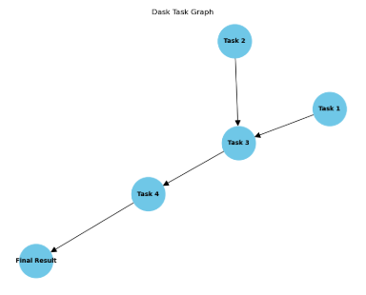
Workflow Demo
workflow_planning.ipynb
Tasks are discrete units of work that are run on workers.
Task dependencies are the order and conditions under which tasks execute.
Callbacks: Actions to take when the entire workflow completes.
Schedules determine when the workflow should run.

Slide 49
API/SDK Demo
What we’re doing:
Demonstrate multiple methods for processing GNSS observation data in the SAGE/GAGE GeoLab in AWS
Comparisons:
1. Serial download and process: in GeoLab
2. TileDb read and process in GeoLab
3. Serial read from S3 and process in GeoLab
4. Parallel read and process using Dask-Gateway in GeoLab

Slide 50
Serial Download & Process
Key points:
Files are individually downloaded from GNSS web services
Data from each file is extracted and added to xarray
Average SNR is calculated and plotted
Processed 9 days in 30 seconds

Slide 51
Read from TileDB in S3
Key points:
In GeoLab, perform a serial read against TileDB
TileDB queries are efficient, getting only the data needed
Process 50 days in ~30 seconds

Slide 52
Dask in GeoLab
Dask is a open-source Python library for parallel and distributed computing.
Dask breaks down large computational tasks into smaller, manageable pieces that can be processed in parallel.
Dask builds a plan (or task graph) of all the steps needed to complete the computation (lazy evaluation).
The task graph outlines the sequence of operations. Nodes represent a task, and edges are dependencies. The graph optimizes the order of operations and distributes them efficiently across available resources.
The actual calculations are only done when you explicitly ask for the results.

Slide 53
Dask Gateway in GeoLab
Key points:
A distributed compute infrastructure (dask-gateway) adjacent to ARCO data supports:
high throughput, massively parallelizable workflows
large scale data analysis
Machine learning + deep learning
Processed 440 days in ~30 seconds

Slide 54
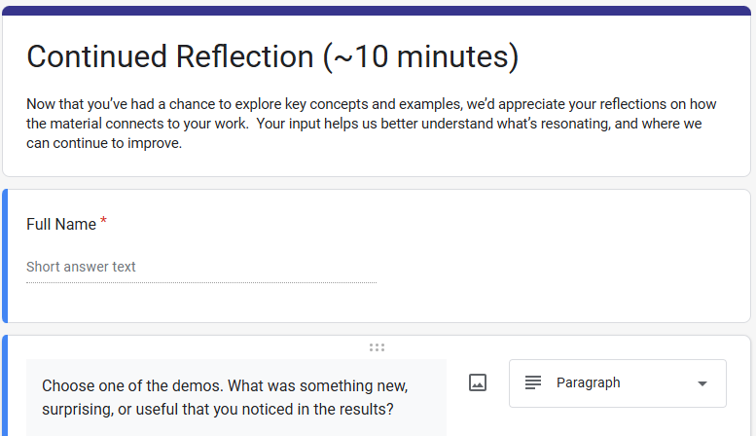
Take 10 minutes to Reflect
Please take 10 minutes to complete the short reflection linked in the online agenda
This reflection is a chance to check in with what we’ve covered so far, and give us insight into how it’s landing for you.
Please open the link in the agenda under hour 3 to begin
earthscope.org/cloud-101

Slide 55
Exploration, Next Steps, Wrap-Up

Slide 56
Wrap-Up
Resources:
ReadtheDocs (https://docs.earthscope.org/projects/GeoLab)
Markdown cheat sheet
Getting data explainer

Slide 57
Wrap Up
Exploration:
Seismic data and obspy exercise
seismic-exercise.ipynb
GNSS and georinex exercise
gnss-exercise.ipynb
Earthquake picking and detection with Seisbench
EQ_Detection_Seisbench.ipynb

Slide 58
Wrap-Up
Discussion
Questions?
Ideas!
How will you use GeoLab?
Survey - your input helps us shape future training and support.
Please open the link in the agenda in hour 4
earthscope.org/cloud-101

